Slide 1
Data Structure
(Chapter 1.4)

Slide 2
Data Structures
Often… the way you organize the data affects the performance of your algorithm
A data structure is a particular way of storing and organizing data
Part of algorithm design is choosing the right data structure

Slide 3
Fundamental Data Structures
Linear Data Structure
Array
Linked list
Stack
Queue
Set
Dictionary (Map)
Tree
Graph

Slide 4
Arrays
A sequence of n items of the same type, accessed by an index
The good:
Each item accessed in same constant time
The bad:
Size is fixed
Insertion / deletion in an array is time consuming – all the elements following the inserted element must be shifted appropriately
Item[0]
Item[1]
…
Item[n-1]

Slide 5
Fundamental Data Structures
Linear Data Structure
Array
Linked list
Stack
Queue
Set
Dictionary (Map)
Tree
Graph

Slide 6
Linked Lists
(singly) A sequence of zero or more elements called nodes, consisting of data and a pointer
(doubly) Pointers in each direction
Item 0
Item 1
Item n-1
Item 0
Item 1
Item n-1

Slide 7
Linked Lists
Linked list provides following two advantages over arrays
Dynamic size based on number of elememnts
Ease of insertion/deletion – O(1)
Linked lists have following drawbacks:
Random access is not allowed.
Search and access is time consuming – O(n)

Slide 8
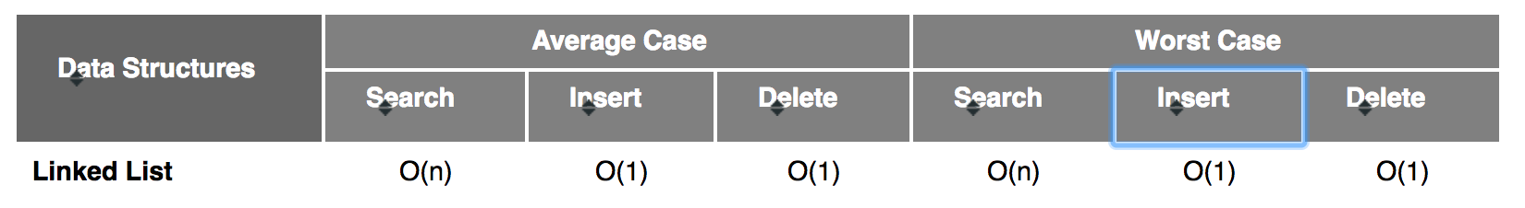
Linked Lists
http://cooervo.github.io/Algorithms-DataStructures-BigONotation/index.html

Slide 9
Fundamental Data Structures
Linear Data Structure
Array
Linked list
Stack
Queue
Set
Dictionary (Map)
Tree
Graph

Slide 10
Stack
Like a stack of plates
Last-in-first-out (LIFO)
Item
Item
pop
push
Item
peek
Item
Item
Item

Slide 11
Stack
the insert operation is called Push
the delete operation is called Pop
Example:
Analysis of languages (e.g. properly nested brackets)
Properly nested: (())
Wrongly nested: (()

Slide 12
Stack
CheckBalancedParenthesis(exp)
n ← length(exp)
Create a stack s
2. for i ← 0 to n-1 do
3. if (exp[i] is ‘(‘ ) do
6. Push (exp[i])
else if (exp[i] is ‘)‘ )
if(s is empty or dose not pair with exp[i])
return False
else
pop()
If (s is empty)
return true
else
return false

Slide 13
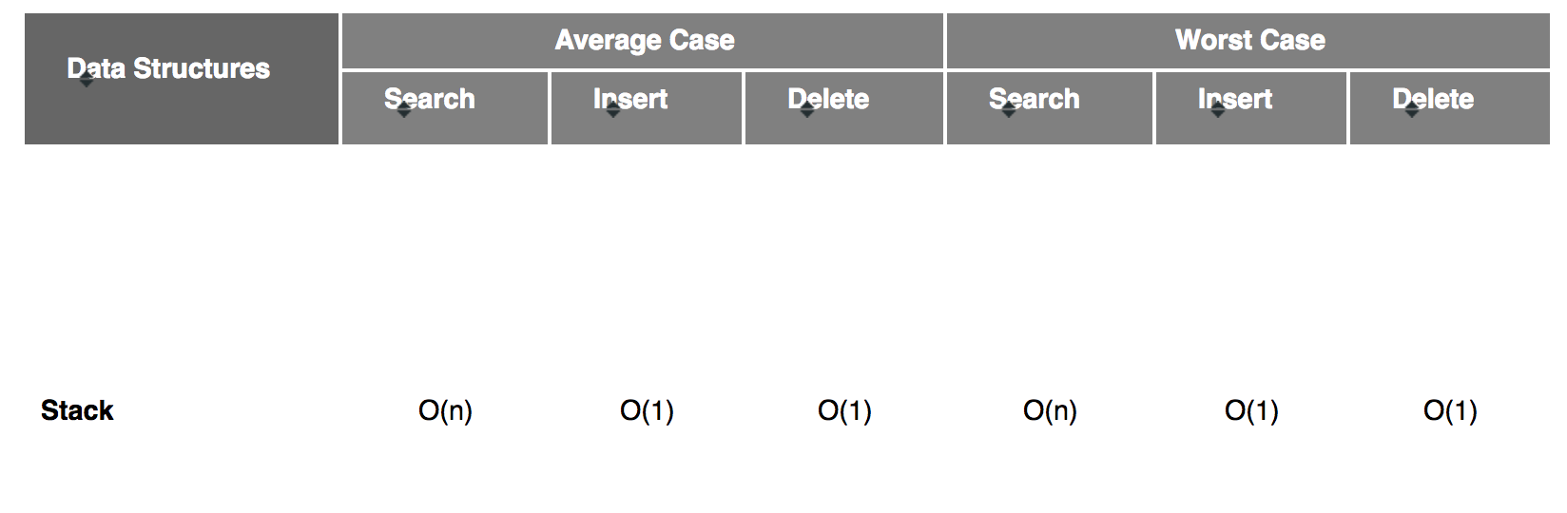
Stack
http://cooervo.github.io/Algorithms-DataStructures-BigONotation/index.html

Slide 14
Queues
Like a line up
First-in-first-out (FIFO)
Item
dequeue
Item
peek
Item
Item
Item
enqueue
Item

Slide 15
Queue
http://bigocheatsheet.com/

Slide 16
Fundamental Data Structures
Linear Data Structure
Array
Linked list
Stack
Queue
Set
Dictionary (Map)
Tree
Graph

Slide 17
Set
a Set is just like a Set in math, ie: set = { 1, 2, 3, 4 }
the key thing to remember:
sets cannot contain duplicate items
all we can really do with a set is:
add things into it
take things out of it
check if it contains something
iterate over the Set (examine each item, one-by-one)

Slide 18
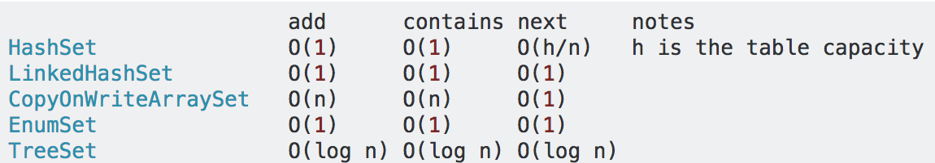
Set in java
there are a few different ways to implement Set
HashSet:
HashSet is the fastest implementation, but it is unordered
TreeSet
TreeSet is slower, but maintains a sorted order
http://stackoverflow.com/questions/559839/big-o-summary-for-java-collections-framework-implementations

Slide 19
Fundamental Data Structures
Linear Data Structure
Array
Linked list
Stack
Queue
Set
Dictionary (Map)
Tree
Graph

Slide 20
Map (as a hash table)
INDEXES
KEY:VALUE PAIRS (records)
0
KEY
danelectro
DC3
1
fender
2
.
.
.
a Map is a lookup table that takes a key and returns a value
the most common implementation is as a hashtable (hashmap)
hash
function
translates
key into
index
471
gretsch
472
fender
telecaster
.
.
.
793
gretcsh
white falcon
danelectro
794
.
.
.

Slide 21
Map (as a balanced tree)
tree implementations, using red-black trees
m
6
root
c
17
p
3
b
75
d
1
s
16

Slide 22
Fundamental Data Structures
Linear Data Structure
Array
Linked list
Stack
Queue
Set
Dictionary (Map)
Tree
Graph

Slide 23
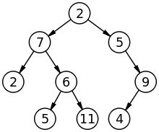
Trees
A connected, acyclic graph
Usually we think of trees as having a root
Representing data in a tree can speed up your algorithms in many natural problems

Slide 24
Binary tree implementation
a
b
c
d
e
f
g
h
i
j
k
l

Slide 25
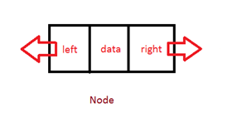
Tree node implementation
public class Node {
public int data;
public Node left;
public Node right;
public Node(int d) {
data = d;
}

Slide 26
Fundamental Data Structures
Linear Data Structure
Array
Linked list
Stack
Queue
Set
Dictionary (Map)
Tree
Graph

Slide 27
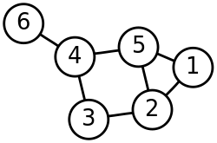
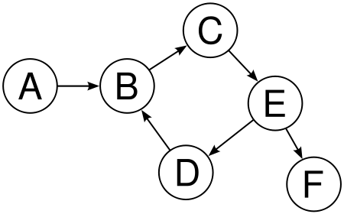
Graphs
G = (V,E)
V is a set of vertices
E is a set of edges
Undirected
Directed

Slide 28
Degree
In-degree(v) – Number of edges facing towards node ‘v’
Out-degree(v) – Number of edges facing outwards from ‘v’

Slide 29
Representing Graphs
Adjacency matrix
Adjacency lists

Slide 30
Representation: Adjacency Matrix
Adjacency matrix is the following:
 | a | b | c | d | e | f | g
a | 0 | 1 | 1 | 0 | 0 | 0 | 0
b | 1 | 0 | 1 | 1 | 0 | 0 | 0
c | 1 | 1 | 0 | 1 | 0 | 0 | 0
d | 0 | 1 | 1 | 0 | 1 | 0 | 1
e | 0 | 0 | 0 | 1 | 0 | 1 | 1
f | 0 | 0 | 0 | 0 | 1 | 0 | 0
g | 0 | 0 | 0 | 1 | 1 | 0 | 0
For this graph:

Slide 31
Representation: Adjacency List
For this graph:
Adjacency list is the following:
For vertex a:
For vertex b:
For vertex c:
For vertex d:
For vertex e:
For vertex f:
For vertex g:
b
c
a
c
d
a
b
d
b
c
e
g
d
f
g
e
d
e

Slide 32
Representing Graphs
Adjacency matrix
Or Weight Matrix for weighted graphs
Adjacency lists
A list of vertices connected to each vertex
Which one to use?
Depends on the nature of the graph (sparse or not)
Depends on the algorithm
Notes:
For sparse graph the adjacency list use less space than the matrix.
This situation is exactly opposite for dense graph.

Slide 33
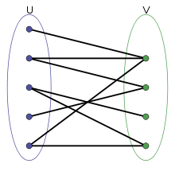
Properties
Connected graph
A graph where there is a path connecting each pair of vertices
Bi-partite graph
Vertices can be divided into two separate sets u and v, so that all edges go from set u to set v

Slide 34
Properties
Cyclic graph
A graph containing at least one cycle
(must have 3 vertices)
Acyclic graph
A graph containing no cycles

Slide 35
Graph Algorithm
(Chapter 3.5)

Slide 36
Graph Traversal
Many real-world problems require processing of each vertex (or edge) in a graph
Routing a message on a network
Web crawling
Social network
Network broadcast
Garbage collection
Notes:
1- Web crawling
2-Socila network
3- Network broadcast
4- Garbage collection
5-solving puzzle

Slide 37
Graph Traversal Algorithms
Graph traversal algorithms give a method for systematically processing all vertices
Two approaches:
Depth-First Search (DFS)
Breadth-First Search (BFS)
Idea: "visit" all the vertices, one at a time,
marking them as we visit them

Slide 38
Depth-First Search (DFS)
Visits all vertices by always moving away from the last vertex visited (if possible)
Backtracks if there are no more adjacent vertices
Implementation often uses a stack of vertices being processed
“Re-draws” graph in a tree-like fashion

Slide 39
DFS
Algorithm:
DFS(G):
init all visited values to false
for each vertex v in V // where G = {V,E}
if v has not been visited
dfs(v)
dfs(v)
visit node v
for each vertex w in V adjacent to v
if w has not been visited
dfs(w)
the statement "visit node v" should be replaced by whatever you are doing
the output is typically a “DFS Tree”, which is a tree containing all the edges that are used to visit node
edges that are in G, but not in the DFS Tree are called “back edges”

Slide 40
DFS Example (using the algorithm)
Notes: To trace the operation algorithm we use a stack.
When we make a recursive call (eg (dfs(v)), we push v onto the stack.
When v becomes a dead-end (ie: no more adjacent unvisited neighbors) it is popped off the stack.
Typically we break ties for next unvisited neighbor by using alphabetical order.
a
b
c
d
e
f
g
h

Slide 41
DFS Example (using the algorithm)
a
b
c
d
e
f
g
h
DFS: a b f e g c d h
h
d
c
g
e
f
b
a

Slide 42
Uses of DFS
DFS is commonly used to:
find a spanning tree
find a path from v to u (ie: get out of a maze)
find a cycle
find all connected components

Slide 43
Efficiency of DFS
the basic operation is:
for each vertex w in V adacent to v
if w has not been visited
dfs(w)
we can see that this operation will be performed once for each vertex that occurs in the underlying graph structure
therefore the #basic ops depends on the size of the structure used to implement the graph
basically we need to visit each element of the data structure exactly once. so the efficiency must be:
O(|V|²) - for adjacency matrix
O(|V|+|E|) for adjacency lists

Slide 44
Breadth-first search (BFS)
Visits graph vertices by moving across to all the neighbors of last visited vertex
Instead of a stack, BFS uses a queue
Similar to level-by-level tree traversal
“Redraws” graph in tree-like fashion (with tree edges and cross edges for undirected graph)

Slide 45
Breadth First Search
Informally:
for each vertex v in V
visit all vertices adjacent to v
when all vertices have been visited, visit all vertices 2 hops away
continue in this way until all have been visited

Slide 46
BFS Algorithm
BFS(G):
init all visited flags to false
for each v in V
if v has not been visited
bfs(v)
bfs(v)
visit node v
initialize a queue Q
add v to Q
while Q is not empty
for each w adjacent to Q.head
if w has not been visited
visit node w
add w to Q
remove Q.head from Q
the statement "visit node v|w" can be replaced by whatever you are doing
use a queue (FIFO) to determine which vertex to visit next
edges that are in G, but not in the resulting BFS tree are called cross-edges

Slide 47
BFS Example (using the algorithm)
a
b
c
d
e
f
g
h
d
h
c
g
f
e
b
a
BFS: a b e f g c h d

Slide 48
Notes on BFS
BFS has same efficiency as DFS and can be implemented with graphs represented as:
adjacency matrices: O(V²)
adjacency lists: O(|V|+|E|)
Yields single ordering of vertices (order added/deleted from queue is the same)

Slide 49
BFS Applications
Really the same as DFS
But… with some judgment… there are applications where BFS seems better:
Finding all connected components in a graph
Traversing all nodes within one connected component (friends in facebook)
Finding the shortest path (number hops) between two connected vertices

Slide 50
BFS vs DFS

Slide 51
DFS
DFS:
abcdefghijklm
DFS:
123456789

Slide 52
BFS
abcdmlkjihgfe
BFS:
BFS:
12483765

Slide 53
Problems
In many problems… we need to traverse a graph
Either DFS or BFS will work
But one is better
Consider some examples…

Slide 54
Problem 1: Spanning Tree
Spanning Tree: A line that connects all nodes together. (if connections exist)
Given a connected graph G, use BFS or DFS to construct a spanning tree of G.
use BFS so that we get “shorter” paths between vertices
this is a straight-up application of BFS, just build a new graph (the spanner) as we go

Slide 55
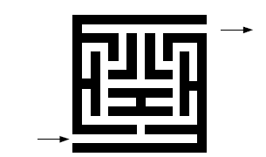
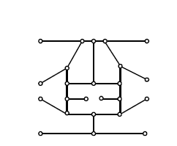
Problem 2: Maze Solving
Model the following maze as a graph. Use DFS to find a path through the maze
use DFS because its tree is constructed by moving along existing edges (in contrast, BFS keeps back-tracking to the parent node, so you would have to walk further)

Slide 56
Problem 3: Shortest Path
Use BFS to find the shortest path between two connected vertices, u and w
use BFS because it will find a shortest path (DFS will find “a path” – not always the shortest one)
Step 1: run bfs(u) to create a spanning tree T rooted at u (all paths from in T, starting at root, are shortest)
Step 2: extract the path from T
use DFS on T, to find any path (as in the previous problem),

Slide 57
Problem 4: Find Cycles
Explain how you can use BFS or DFS to determine if a graph is acyclic
either will work
need to quit when we have a cycle (we attempt to visit a neighbor, but it has already been visited)

Slide 58
Problem 5: Determine Connectivity
Explain how you can use BFS or DFS to determine if a graph is connected
either will work
modify the first loop so that it calls dfs|bfs on any vertex. If there are any unvisited vertices when it returns, the graph is not connected

Slide 59
Try it/ homework
Chapter 1.4, page37, question 1,3,9
Chapter 3.5, page 128, questions 1,2,4,10

